Slide 1
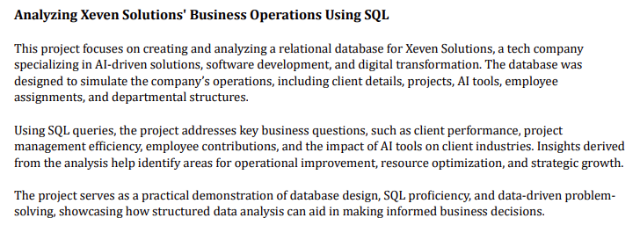

Slide 2
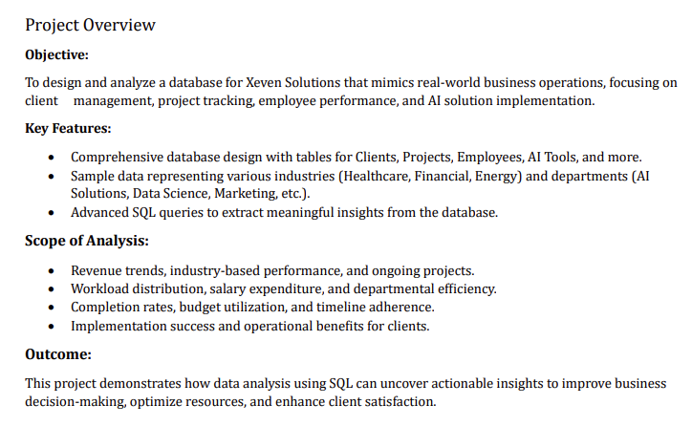

Slide 3
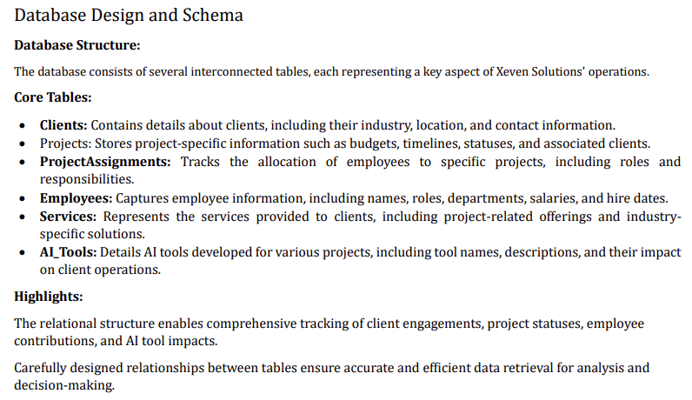

Slide 4
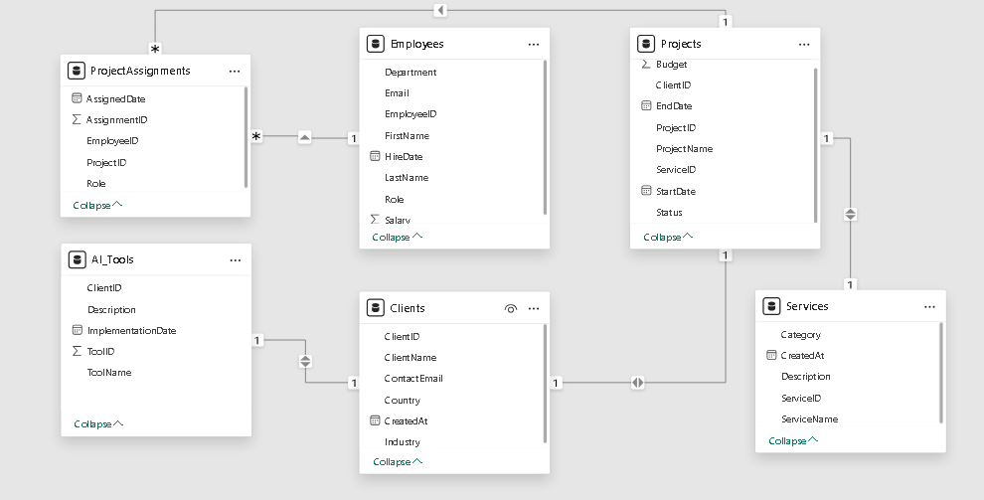

Slide 5

1. Client-Focused Queries :
1. Which client has the highest number of ongoing projects?
SELECT TOP 1
c.ClientName,
COUNT(p.ProjectID) AS OngoingProjectCount
FROM Projects p
JOIN Clients c ON p.ClientID = c.ClientID
WHERE p.Status = 'Ongoing'
GROUP BY c.ClientName
ORDER BY OngoingProjectCount DESC;

Slide 6

1. Client-Focused Queries :
2. What is the total revenue (budget) generated by projects for clients in the healthcare industry?
SELECT
SUM(p.Budget) AS TotalRevenue
FROM Projects p
JOIN Clients c ON p.ClientID = c.ClientID
WHERE c.Industry = 'Healthcare';

Slide 7

1. Client-Focused Queries :
3.How many clients have active AI tools implemented by Xeven Solutions?
SELECT COUNT(DISTINCT c.ClientID) AS ActiveAIClients
FROM AI_Tools at
JOIN Clients c ON at.ClientID = c.ClientID
WHERE at.ImplementationDate IS NOT NULL;

Slide 8

1. Client-Focused Queries :
4. What is the average project budget for clients in the energy sector
SELECT
AVG(p.Budget) AS AverageProjectBudget
FROM
Projects p
JOIN
Clients c ON p.ClientID = c.ClientID
WHERE
c.Industry = 'Energy';

Slide 9

2. Employee-Focused Questions:
1. Which employee has worked on the greatest number of projects?
SELECT TOP 1
e.FirstName,
e.LastName,
COUNT(pa.ProjectID) AS ProjectCount
FROM
Employees e
JOIN
ProjectAssignments pa ON e.EmployeeID = pa.EmployeeID
GROUP BY e.FirstName, e.LastName
ORDER BY ProjectCount DESC
;

Slide 10

2. Employee-Focused Questions:
2. What is the average salary for employees working in the AI Solutions department?
SELECT
AVG(e.Salary) AS AverageSalary
FROM
Employees e
WHERE
e.Department = 'AI Solutions';

Slide 11
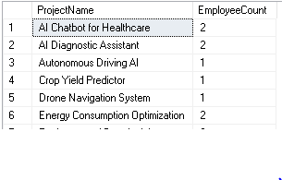
2. Employee-Focused Questions:
3. How many employees have been assigned to each project? Which projects are under-resourced?
SELECT
p.ProjectName,
COUNT(pa.EmployeeID) AS EmployeeCount
FROM ProjectAssignments pa
JOIN Projects p ON pa.ProjectID = p.ProjectID
GROUP BY p.ProjectName
HAVING COUNT(pa.EmployeeID) < 3;

Slide 12

2. Employee-Focused Questions:
4. How many employees have a role in the data science department?
SELECT
COUNT(e.EmployeeID) AS EmployeeCount
FROM Employees e
WHERE e.Department = 'Data Science';

Slide 13

2. Employee-Focused Questions:
5. What is the total salary expenditure for all employees assigned to the "Healthcare" industry projects?
SELECT
SUM(e.Salary) AS TotalSalaryExpenditure
FROM ProjectAssignments pa
JOIN Employees e ON pa.EmployeeID = e.EmployeeID
JOIN Projects p ON pa.ProjectID = p.ProjectID
JOIN Clients c ON p.ClientID = c.ClientID
WHERE c.Industry = 'Healthcare';

Slide 14

3. Project-Focused Questions:
1. Which projects are currently paused and why?
SELECT
p.ProjectName
FROM Projects p
WHERE p.Status = 'Paused';

Slide 15

3. Project-Focused Questions:
2. What is the overall project completion rate for all projects?
SELECT
(CAST(COUNT(CASE WHEN p.Status = 'Completed' THEN 1 END) AS FLOAT) / COUNT(p.ProjectID)) * 100 AS CompletionRate
FROM
Projects p;

Slide 16

3. Project-Focused Questions:
3. How many projects have been completed within the set timeline versus those that have gone beyond their expected end date?
SELECT
SUM(CASE WHEN p.EndDate <= p.EndDate THEN 1 ELSE 0 END) AS ProjectsOnTime,
SUM(CASE WHEN p.EndDate > EndDate THEN 1 ELSE 0 END) AS ProjectsOverdue
FROM
Projects p;

Slide 17

4. AI Tool and Solution-Focused Questions:
4.AI Tool and Solution-Focused Questions:
SELECT
COUNT(at.ToolID) AS TotalAI_Tools,
STRING_AGG(at.Description, ', ') AS ToolImpact
FROM
AI_Tools at;

Slide 18
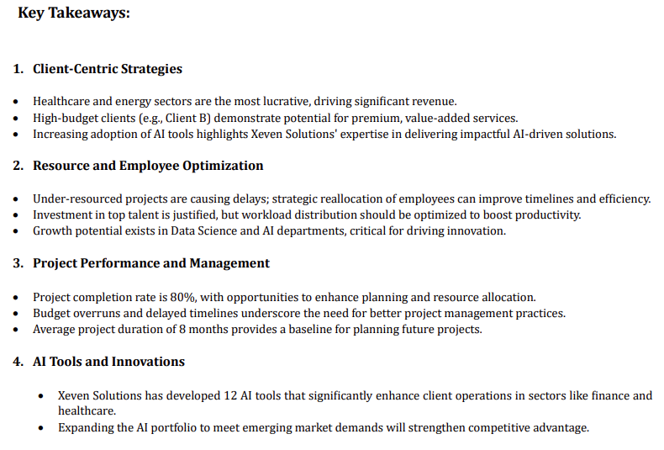

Slide 19
